Slide 1

GG5069, GG5070 (2023-24): WebGIS and Online Mapping
Assignment 2 | WebGIS | Market Analysis
Iram Irshad Baqri | 52206768

Slide 2
Introduction
This presentation demonstrates the value of webGIS in market analysis that helps a client company (Hira Salon) understand Qatar’s market to start its operation/business in Qatar through various examples (maps). Three webGIS platforms have been explored in this presentation namely ArcGIS Online, Mango Map and CARTO. But first, let’s look at the definition of what market analysis is, who uses it and who could use it.
Market Analysis
Market analysis is the process of evaluating several facets of a particular market, including competitor activity, industry trends, and customer preferences. Data must be acquired and examined in order to understand the market's size, development potential, target market, and competitive environment. With the use of market analysis, businesses, important stakeholders, entrepreneurs, and government agencies can identify opportunities, make wise decisions, and develop effective marketing strategies.¹ (Sheehan, 2023).
WebGIS and Market Analysis
WebGIS, short for Web Geographic Information Systems, revolutionizes market analysis by seamlessly integrating geographical data into strategic decision-making processes. In the upcoming slides, we'll explore how WebGIS can significantly enhance the efficiency of market analysis, providing quicker insights than ever before, presented in visually appealing formats.

Slide 3
Introduction: Aim and Objectives
Aim
Leverage the geoprocessing tools and capabilities of webGIS platforms to conduct a preliminary. market analysis for starting a beauty salon business in Qatar.
Objectives
Explore three different webGIS platforms tailored for the same preliminary market analysis.
Compare and contrast their interfaces, platforms, and usability.
Demonstrate the use of webGIS in helping the client analyze Qatar's market for starting a beauty salon business.

Slide 4
Plan Flow Chart: Method
Brainstorm ideas where market analysis can be conducted.
Once the area for market analysis is finalized, gather relevant data which includes demographic data, competitor locations, potential suppliers etc.
Once the data is collected and cleaned for analysis, research available webGIS platforms that can be used to conduct a successful market analysis.
Add data to the webGIS to visualise in a way that’s useful for market analysis.
Explore tools, widgets, and different symbolising methods to extract meaningful insights from the spatial data.
Create various informative and appealing maps that demonstrate value of webGIS in market analysis.
Ensure the layer names, zoom levels, labels, pops ups are customised to show only the relevant information to the client.
Evaluate the three platforms, interfaces, usability and recommend the best platform.

Slide 5
Planning, Design and Completion of WebGIS Packages
Planning Stage
Design Stage
Completion Stage
Identify layers to be created that make a good example to demonstrate value of webGIS in market analysis.
Add a suitable theme, title, and logo. Ensure the layer names, zoom levels, labels, pops ups are customised to show only the relevant information to the client.
Publish maps as web maps/apps and ensure the layout is as planned and designed to be.
Identify data required, collect that data and bring it into the webGIS either as zipped shapefile or as a csv.
Explore tools, add widgets, and use varied symbolising options to extract meaningful insights from the spatial data.
Modify and make changes as required to polish the final look.
Finalize the order in which the data layers should appear, the information that should be available as labels/pop ups and identify filters to be set, joints to be made.
Create various informative and appealing maps that demonstrate value of webGIS in market analysis.
Evaluate the three platforms, interfaces, usability and recommend the best platform.

Slide 6


Market Analysis Using WebGIS For Starting A Beauty Salon Business in Qatar

Slide 7
Unlocking Market Insights with WebGIS: Spatial Analysis for Informed Decision-Making
WebGIS (Web Geographic Information Systems) offers significant value for market analysis by providing a dynamic and interactive platform for spatial data visualization, analysis, and decision-making. A few ways in which WebGIS demonstrates its value for market analysis are discussed in the slides to follow:
1. Competitive Analysis:
Competitor Mapping: WebGIS allows for the mapping of competitor locations and market share. This information helps businesses identify areas with high or low competition, informing market entry or expansion strategies (Slide 14,23,31).
2. Geospatial Analysis:
Proximity Analysis: WebGIS enables the analysis of spatial relationships, such as the proximity of businesses to target demographics or competitors. This is crucial for identifying optimal locations for new ventures or assessing market saturation.
Heat Mapping: Utilizing heat maps, businesses can identify hotspots of activity, highlighting areas with high customer density, foot traffic, or potential demand. This aids in strategic decision-making for marketing and expansion (Slide 15,24,32).
Cluster Analysis: Analyze the patterns and trends revealed by cluster analysis to gain strategic insights. Identify areas with high salon concentration and assess opportunities for differentiation or market penetration (Slide 16,33).

Slide 8
Unlocking Market Insights with WebGIS: Spatial Analysis for Informed Decision-Making
3. Market Segmentation:
Demographic Mapping: WebGIS facilitates the mapping of demographic data, helping businesses understand the distribution of their target audience. This is essential for targeted marketing campaigns and product/service customization (Slide 18,19,25,26,34,35).
Customer Profiling: Businesses can use WebGIS to create customer profiles based on location, enabling personalized marketing strategies that resonate with specific geographic segments.
4. Accessibility Analysis:
Public Transport Mapping: Leverage WebGIS to map and analyze the proximity of beauty salons to metro stations. Visualize the accessibility of each salon in relation to public transportation hubs. Extend the analysis to include other transportation modes, such as bus stops or major roadways, to provide a comprehensive view of multi-modal connectivity (Slide 20,28,36).
Supplier Mapping: Utilize WebGIS to map the locations of potential suppliers for beauty salon products. Visualize the proximity of suppliers to your salon locations, allowing for efficient procurement strategies. Identify and assess alternative suppliers in different geographic clusters, reducing dependence on a single source and ensuring a more resilient supply chain (Slide 21,29,37).

Slide 9
Competitive Landscape Analysis
Mapping competitors in the area serves the following purpose in market analysis:
Competitive Landscape Understanding:
Mapping competitors provides a visual representation of the distribution and density of competitors in a specific geographic area. This helps businesses understand the competitive landscape².
Strategic Location Planning:
Mapping competitors assists businesses in strategically planning the location of their own establishments. It helps in identifying optimal locations that may have lower competition or gaps in the market (Nyawira, 2023)³.
Market Trends Analysis:
Over time, changes in the distribution of competitors can indicate shifts in market trends. Mapping competitors enables businesses to stay agile and adapt to evolving market conditions (Nyawira, 2023)³.
Identifying Market Saturation:
By visualizing the locations of competitors, businesses can identify areas that may be saturated with similar offerings. This insight is valuable for determining the level of competition in different regions.
Market Entry and Expansion Strategies:
Businesses can use competitor maps to make informed decisions about entering new markets or expanding existing operations. Understanding the existing players in a region is crucial for successful market penetration.
Risk Assessment:
Businesses can assess the risk associated with specific locations by mapping competitors. High-density areas may pose higher competition and potential challenges, while low-density areas may offer untapped opportunities.
²Mapping services for Location Intelligence and Business Analytics (2023) Utilities One. Available at: https://utilitiesone.com/mapping-services-for-location-intelligence-and-business-analytics (Accessed: 01 December 2023).
³Nyawira, V. (2023) Market mapping, Medium. Available at: https://medium.com/@virginianyawira50/market-mapping-4bd2d0b2baed (Accessed: 01 December 2023).

Slide 10
Strategic Demographic Analysis
Mapping demographic information serves the following purpose in market analysis:
Market Segmentation:
Demographic maps allow for the segmentation of the market based on factors such as age, income, education, and ethnicity. This segmentation aids in tailoring marketing strategies to specific consumer groups (Camilleri, 2017)⁴.
Target Audience Identification:
Mapping demographic data helps businesses identify and visualize the characteristics and distribution of their target audience in specific geographic areas (Camilleri, 2017)⁴.
Site Selection and Location Planning:
When businesses are considering new locations, mapping demographic data assists in selecting sites that align with the characteristics of their target customer base. It helps in optimizing the site selection process⁵.
⁴Camilleri, M.A. (2017) ‘Market segmentation, targeting and positioning’, Tourism, Hospitality &amp; Event Management, pp. 69–83. doi:10.1007/978-3-319-49849-2_4.
⁵Demographic mapping: Unlocking market potential: How demographic mapping enhances geographic segmentation (2023) FasterCapital. Available at: https://fastercapital.com/content/Demographic-mapping--Unlocking-Market-Potential--How-Demographic-Mapping-Enhances-Geographic-Segmentation.html#:~:text=Demographic%20mapping%20helps%20businesses%20gain,can%20inform%20their%20marketing%20strategies. (Accessed: 03 December 2023).

Slide 11
Strategic Location Analysis
Mapping metro stations in the area serves the following purpose in market analysis:
Accessibility:
Proximity to metro stations can enhance the accessibility of your beauty salon, attracting customers who rely on public transportation.
Foot Traffic:
Areas around metro stations often experience high foot traffic, providing increased visibility for your salon and potential walk-in customers.
Demographic Diversity:
Metro stations serve a diverse range of people, potentially exposing your salon to a broad customer demographic.
Transportation Hubs:
Metro stations are central transportation hubs, making your salon easily accessible not only to residents but also to individuals from surrounding areas.
Competitor Analysis:
Mapping metro stations allows you to analyze the competitive landscape in the vicinity, helping you identify areas with fewer competing beauty salons.
Urban Development Indicators:
Metro stations are often situated in areas experiencing urban development and growth, which can be indicative of a flourishing market.

Slide 12
Strategic Location Analysis
Mapping potential supplier in the area serves the following purpose in market analysis:
Supply Chain Optimization:
Mapping potential suppliers helps businesses optimize their supply chain by identifying suppliers in close proximity to their operations. This can lead to reduced transportation costs and improved logistics efficiency.
Market Expansion Strategies:
Mapping suppliers is essential when considering market expansion. It helps businesses evaluate the availability of suppliers in new geographic areas, supporting informed decisions about entering new markets.
Negotiation Leverage:
Businesses can use the information gathered from mapping potential suppliers to negotiate favorable terms. Knowledge of local suppliers and market conditions enhances negotiating leverage.

Slide 13

Market Analysis Using ArcGIS Online

Slide 14
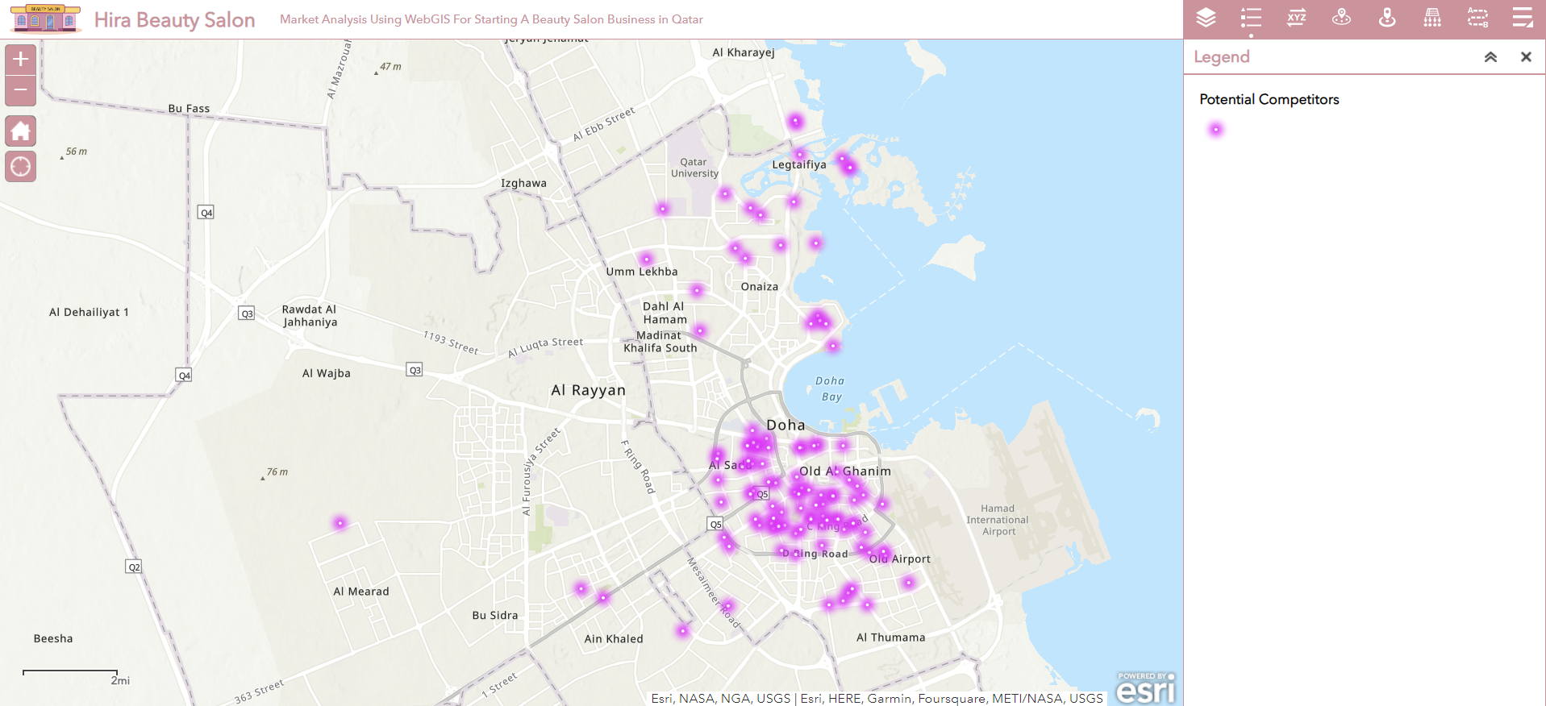
Competitive Landscape Analysis: Mapping Existing Salons
in the Market

Slide 15
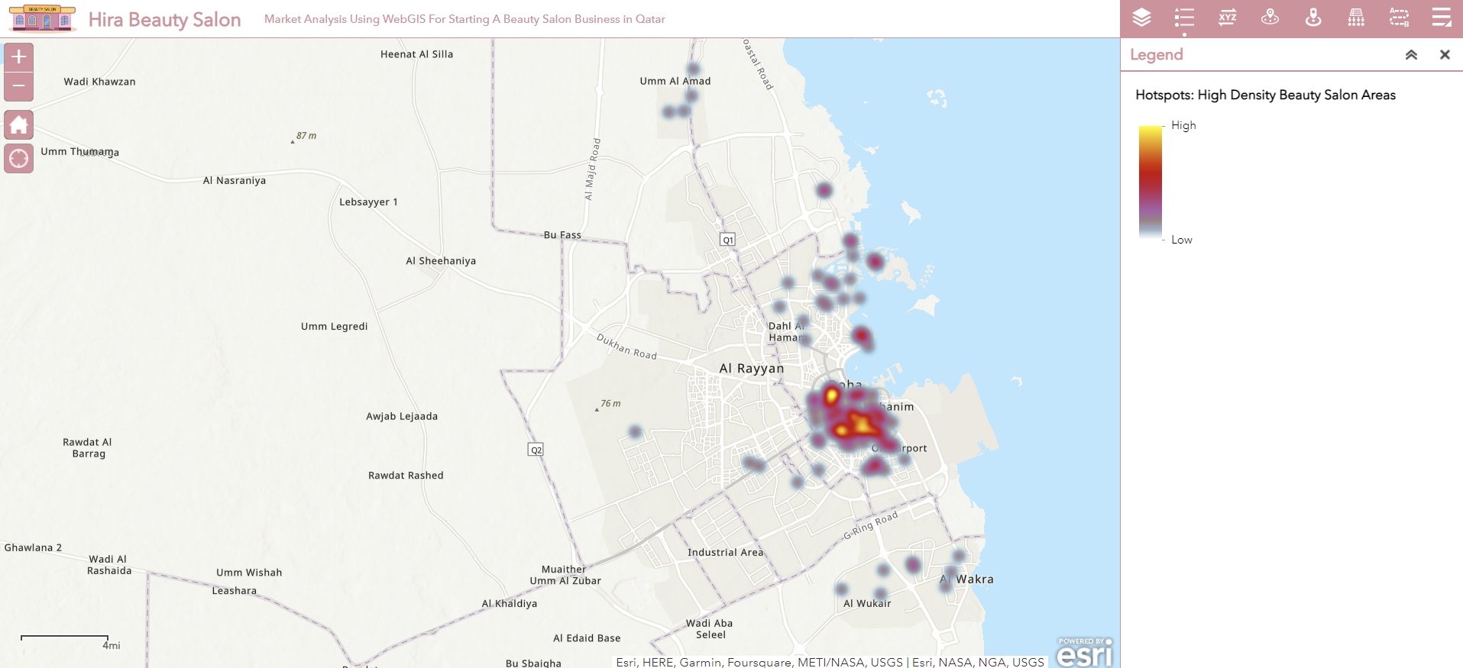
Competitive Landscape Analysis: Heat Map of Existing Salons
in the Market

Slide 16
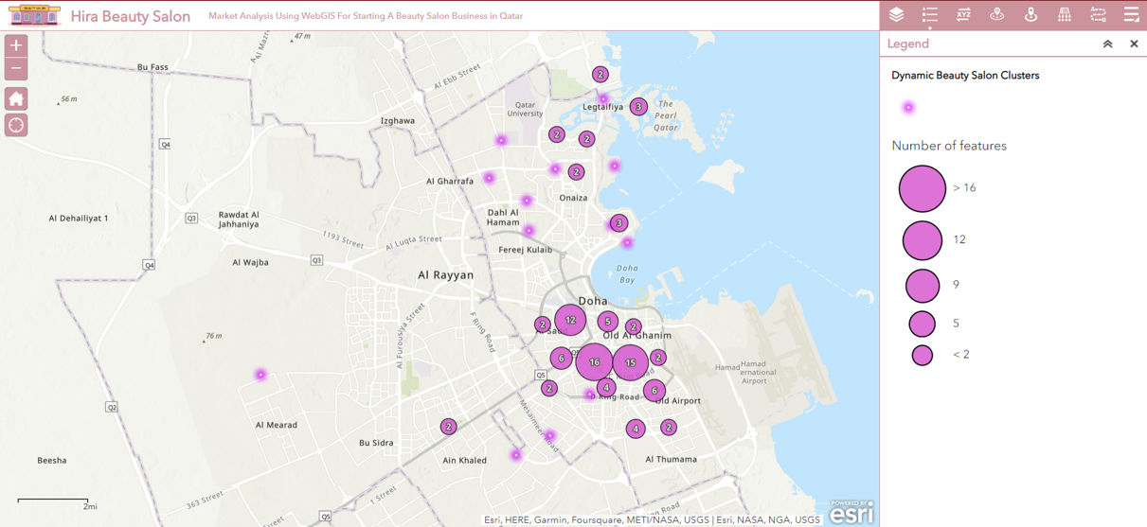
Strategic Cluster Analysis: Identifying Untapped Markets through Salon Density per District

Slide 17
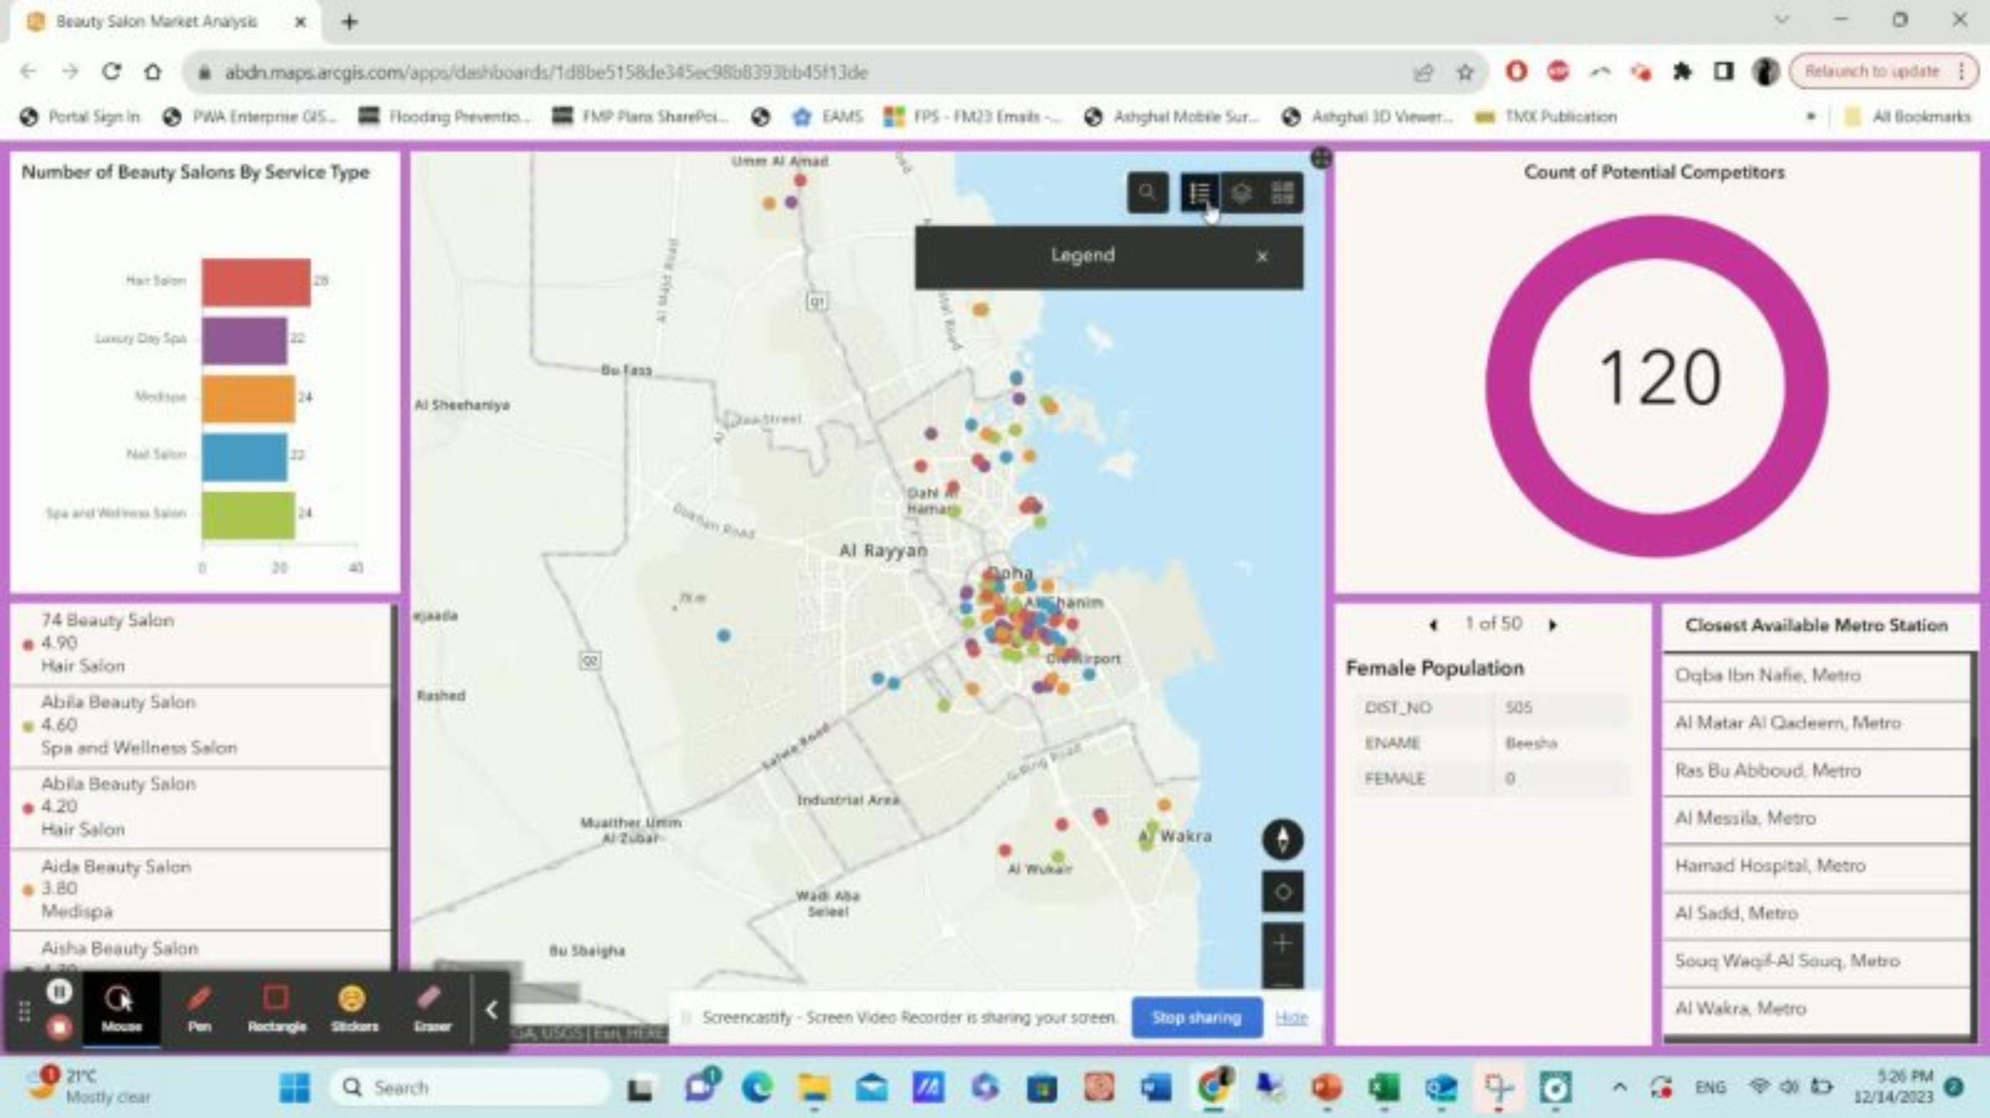
Unlocking Market Insights: WebGIS-Powered Interactive Dashboards for Dynamic Market Analysis
Users can provide location-based statistics using ArcGIS Dashboards by utilising interactive and user-friendly data visualisations on a single screen. ArcGIS Dashboards are a useful tool for any organisation that uses the ArcGIS system to help with decision-making, trend visualisation, real-time status monitoring, and community education. Customise dashboards for your audiences so they may extract the information they require by slicing the data. Similar to maps and apps, dashboards are vital information products that play a crucial role in your geospatial architecture⁶.
⁶ArcGIS dashboards (no date) Data Dashboards: Operational, Strategic, Tactical, Informational. Available at: https://www.esri.com/en-us/arcgis/products/arcgis-dashboards/overview (Accessed: 12 December 2023).

Slide 18
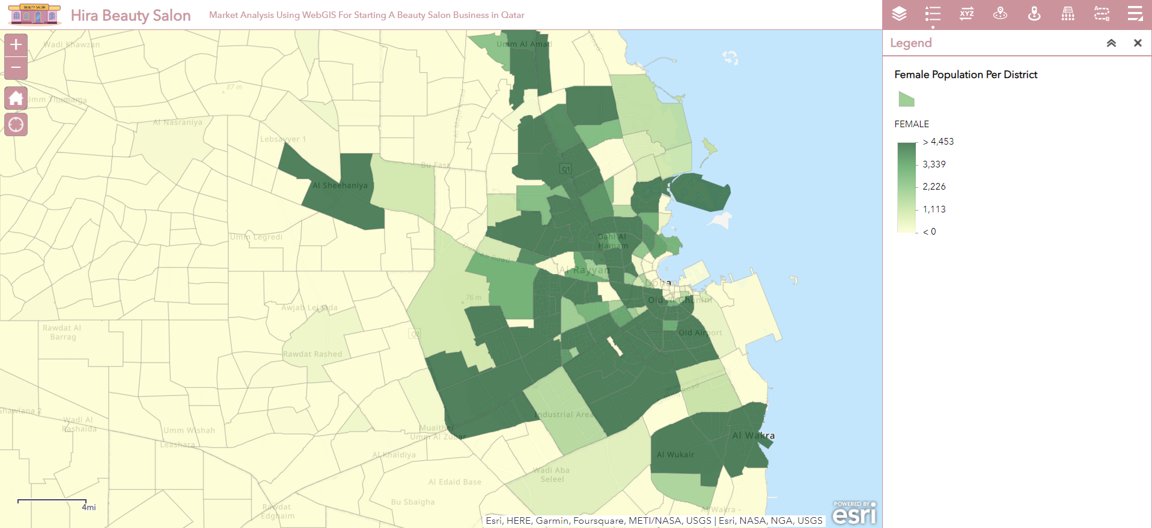
Strategic Demographic Analysis: Mapping Female Population by District for Targeting High-Potential Customer Areas

Slide 19
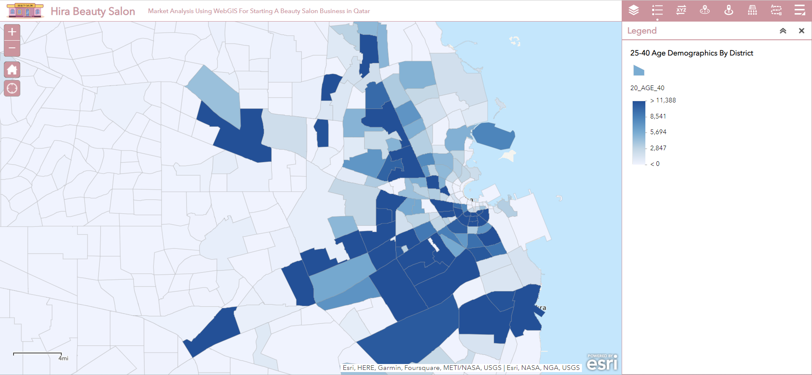
Strategic Demographic Analysis: Mapping Female Population by District for Targeting High-Potential Customer Areas

Slide 20
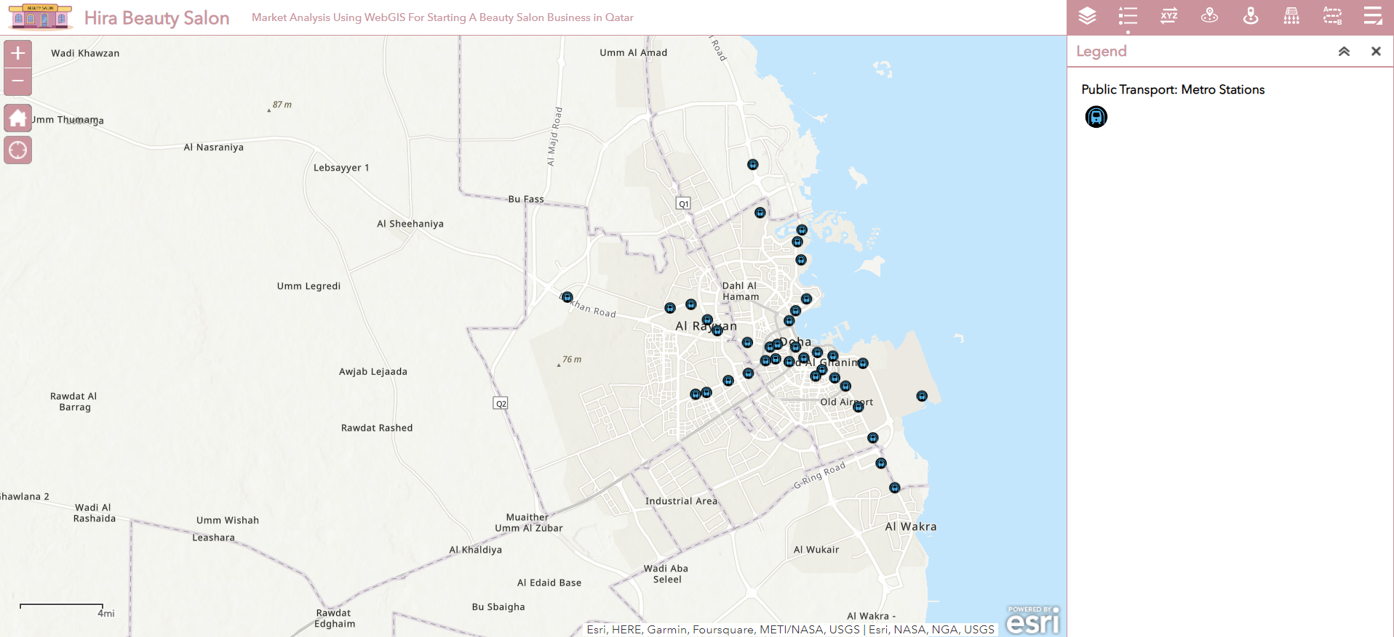
Strategic Location Analysis: Leveraging Metro Stations for Optimal Beauty Salon Placement

Slide 21
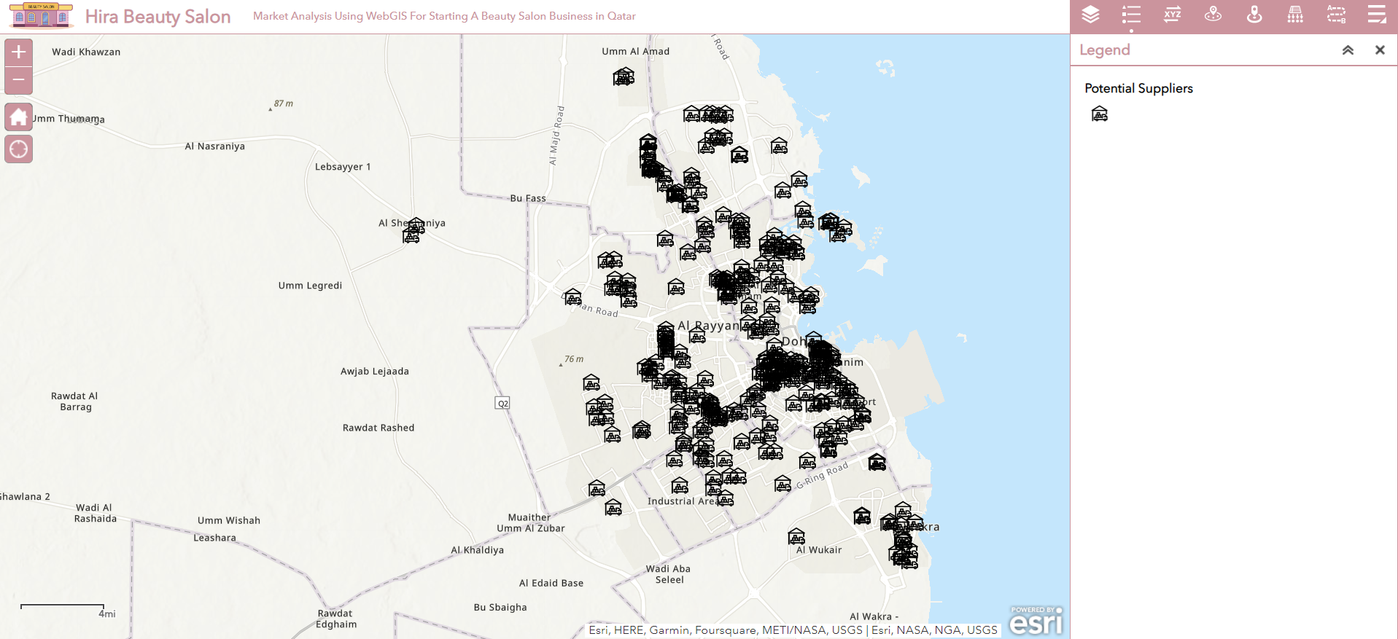
Strategic Location Analysis: Leveraging Suppliers for Optimal Beauty Salon Placement

Slide 22

Market Analysis Using Mango Map

Slide 23
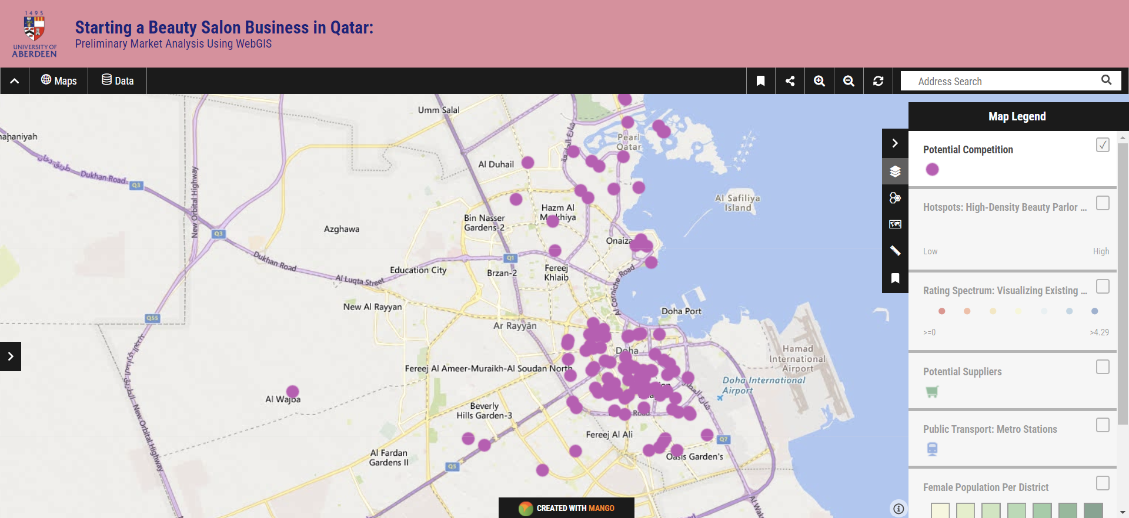
Competitive Landscape Analysis: Mapping Existing Salons
in the Market

Slide 24
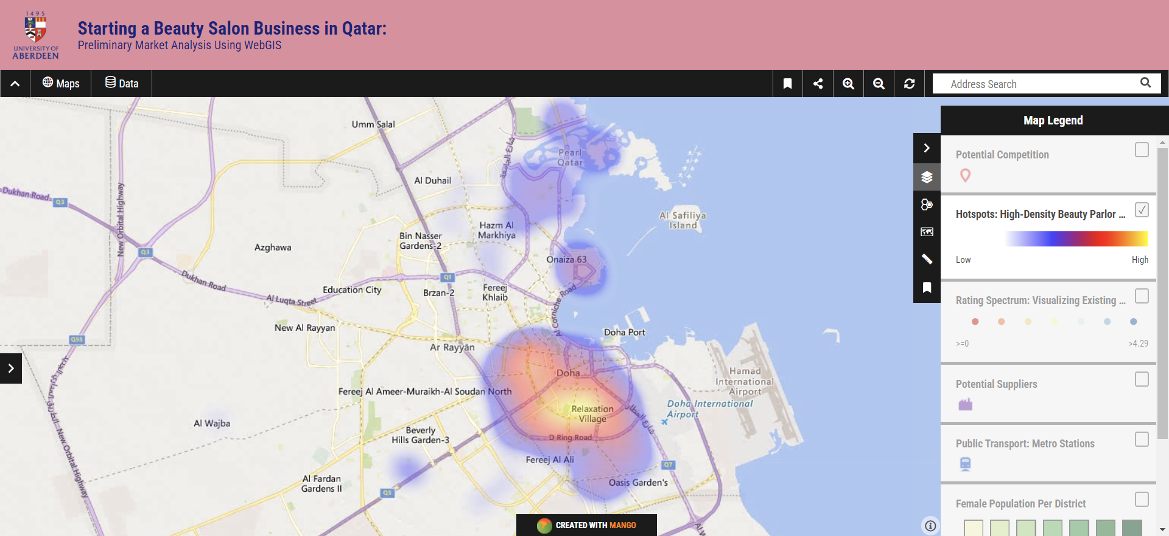
Competitive Landscape Analysis: Heat Map of Existing Salons
in the Market

Slide 25
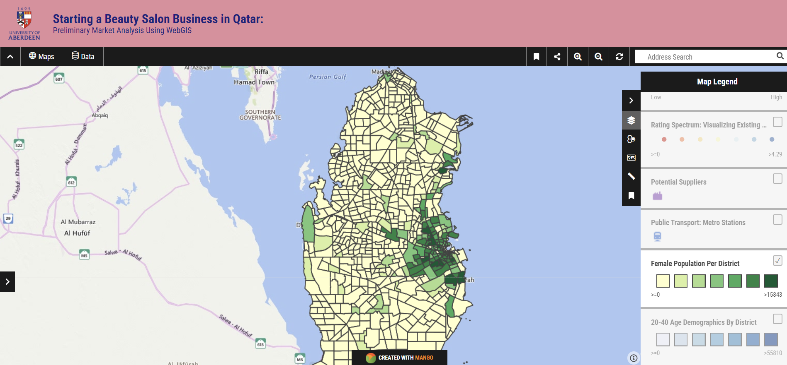
Strategic Demographic Analysis: Mapping Female Population by District for Targeting High-Potential Customer Areas

Slide 26
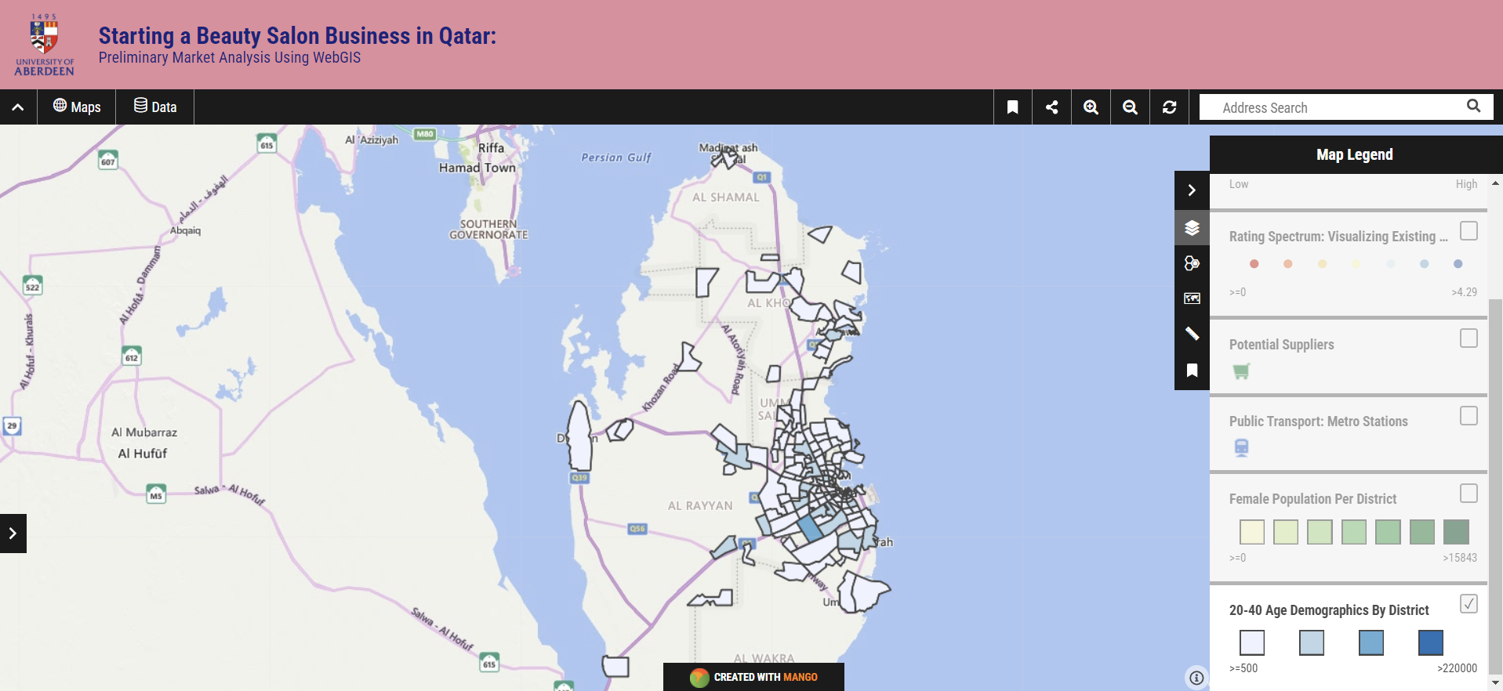
Strategic Demographic Analysis: Mapping Population Aged Between 20-40 For Targeting High-Potential Customer Areas

Slide 27
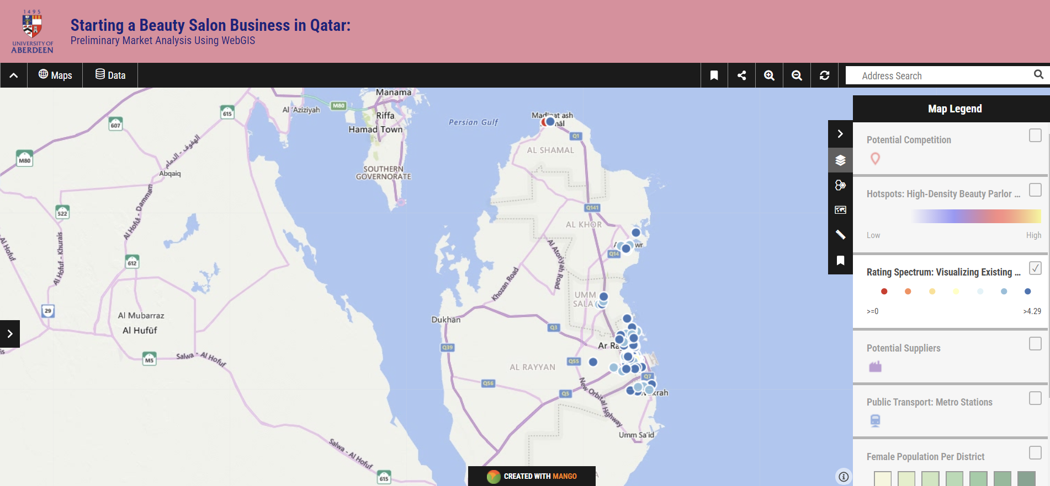
Rating Spectrum: Visualizing Existing Beauty Salons by
Customer Ratings

Slide 28
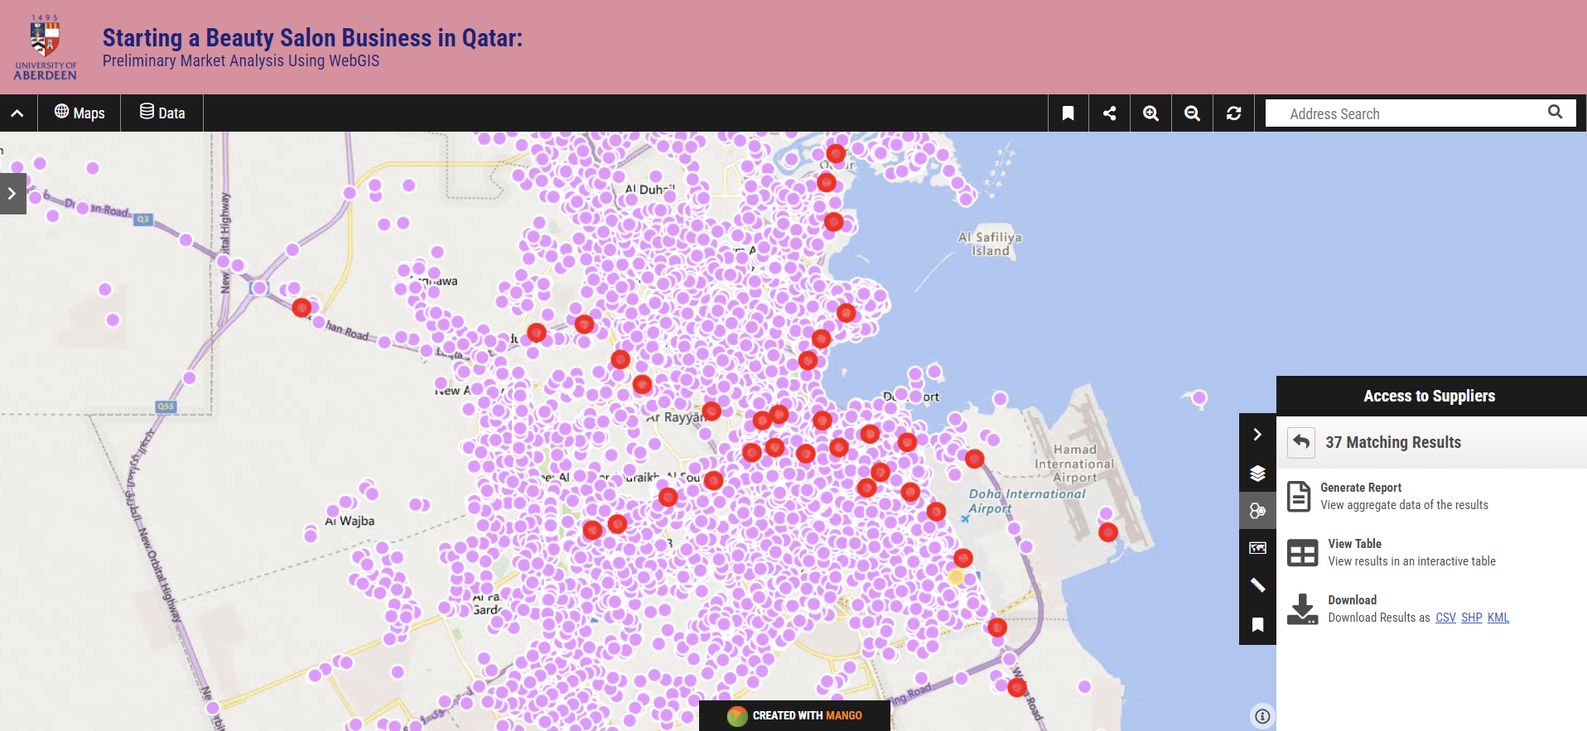
Unlocking Market Insights: Harnessing the Power of Mango Map Query Tool for Rapid Data Exploration
Efficient Layer Highlighting:
From a layer that consists several landmarks, mango map allowed to query the layer to highlight only the metro stations (in red).
Versatile Data Output Options:
Users can seamlessly transition between viewing data in table form, generating detailed reports, or downloading it in CSV, SHP, or KML formats—a versatile feature uncommon in many webGIS platforms.
Layer Management Challenges:
One drawback is that, unlike ArcGIS Online, Mango Map doesn't automatically hide non-queried landmarks or create a new layer displaying only the queried records. This necessitates re-adding as a separate layer using the downloaded CSV or shapefile.
User-Friendly Considerations:
The query tool is a bit a complicated and can be made simpler for ease of user interaction.

Slide 29
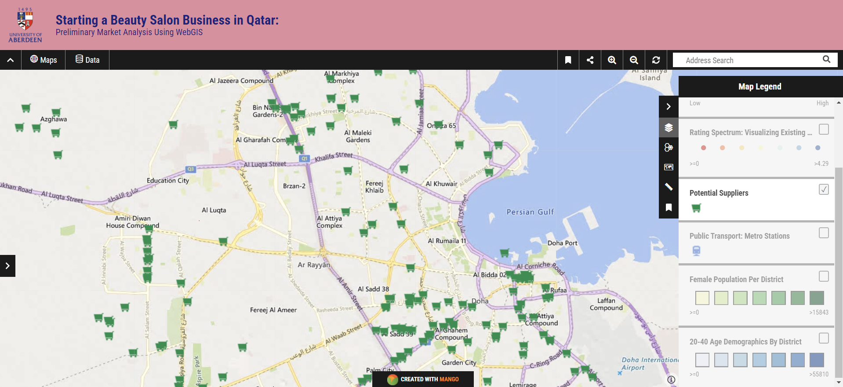
Supplier Landscape Mapping: Analyzing Potential Partners for Beauty Salon Market Success

Slide 30

Market Analysis Using CARTO

Slide 31
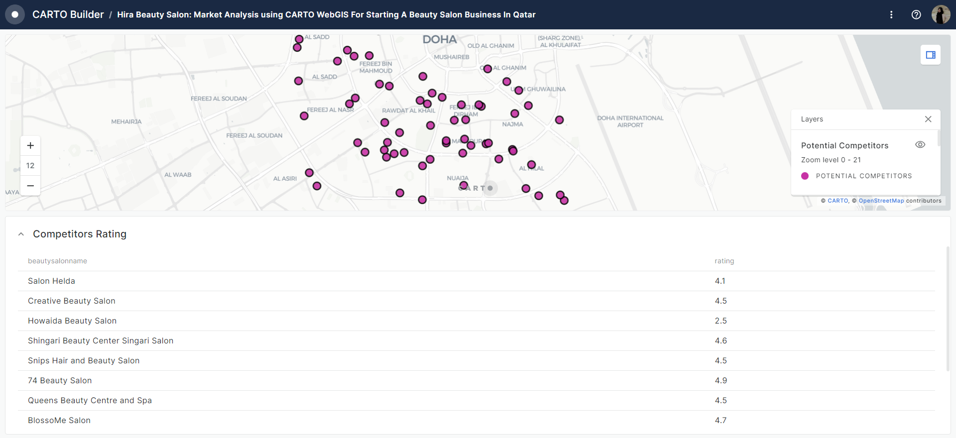
Competitive Landscape Analysis: Mapping Existing Salons
in the Market and Analyzing Their Ratings

Slide 32
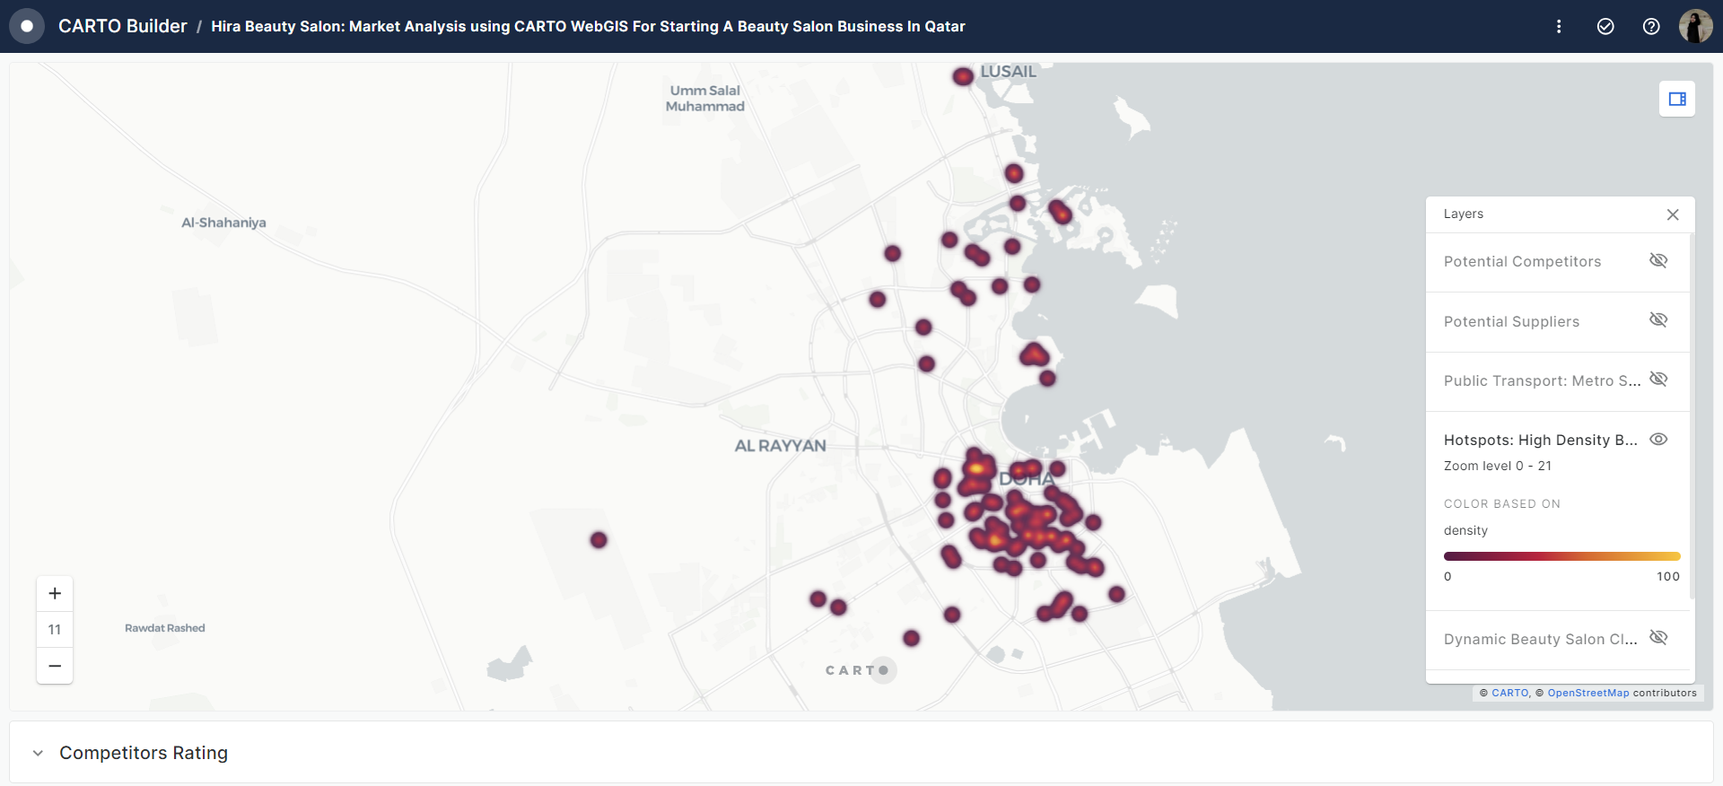
Competitive Landscape Analysis: Heat Map of Existing Salons
in the Market

Slide 33
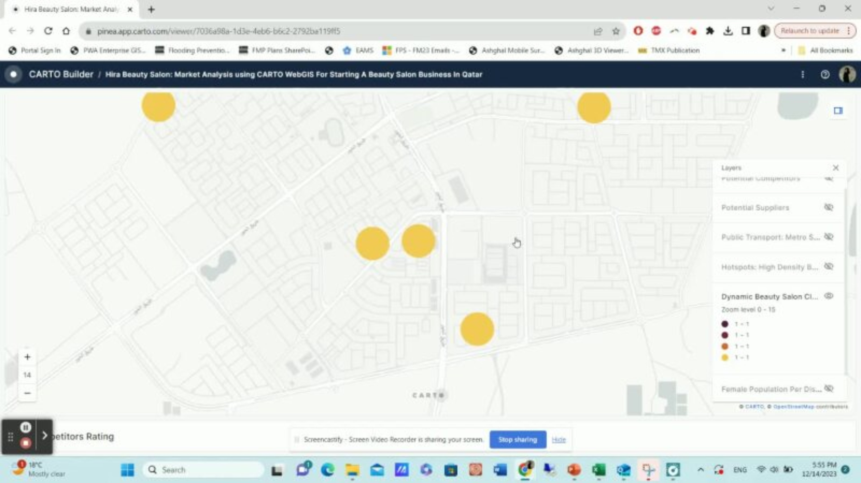
Strategic Cluster Analysis: Identifying Untapped Markets through Salon Density per District
User-Friendly Considerations:
Enabling the label that shows the count per cluster will be beneficial, like in ArcGIS Online.

Slide 34
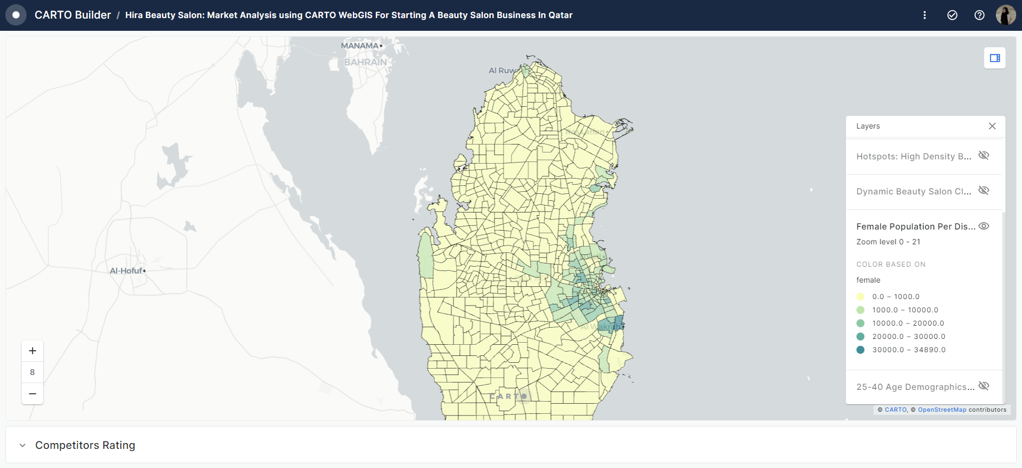
Strategic Demographic Analysis: Mapping Female Population by District for Targeting High-Potential Customer Areas

Slide 35
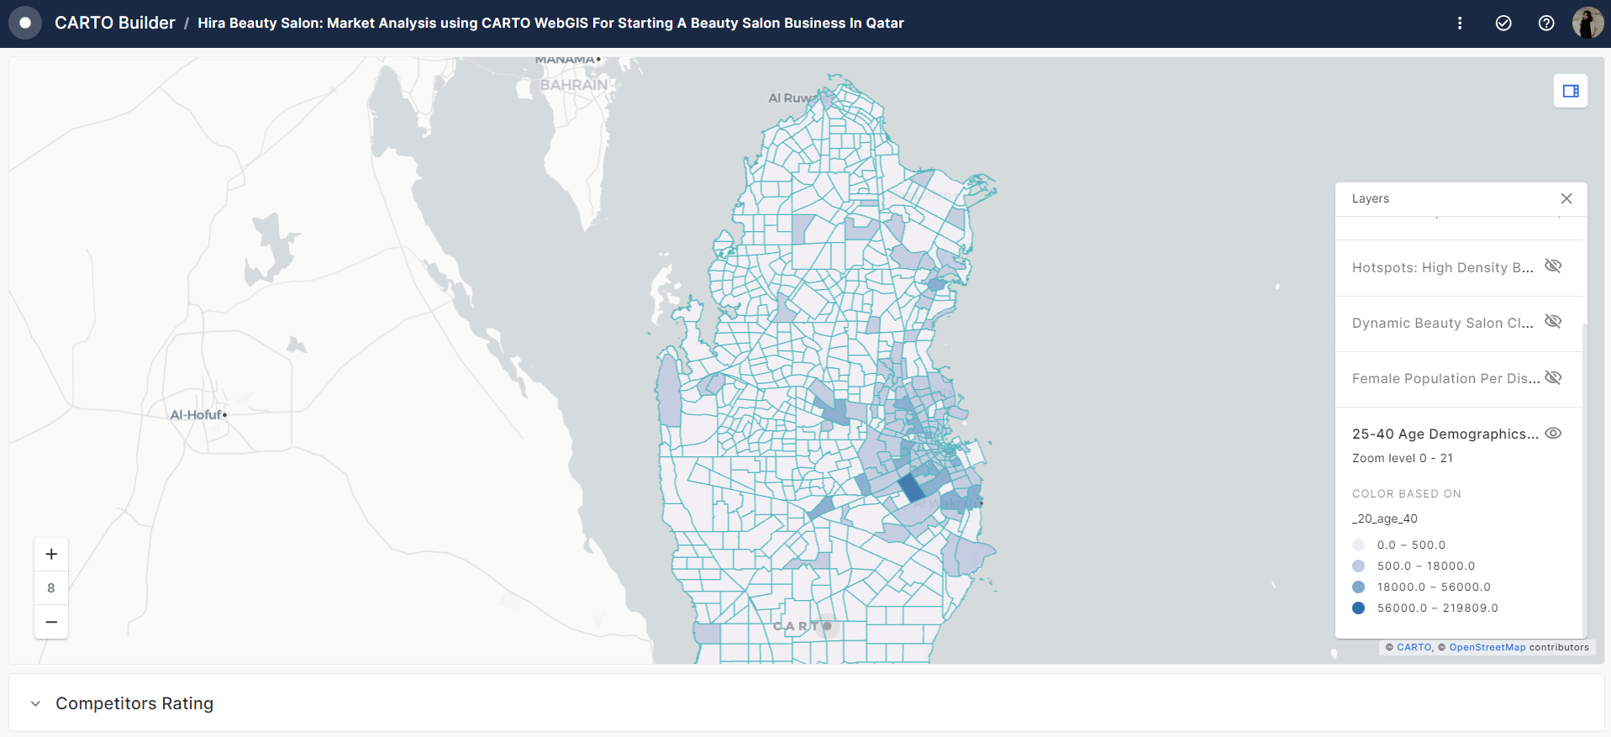
Strategic Demographic Analysis: Mapping Population Aged Between 20-40 For Targeting High-Potential Customer Areas

Slide 36
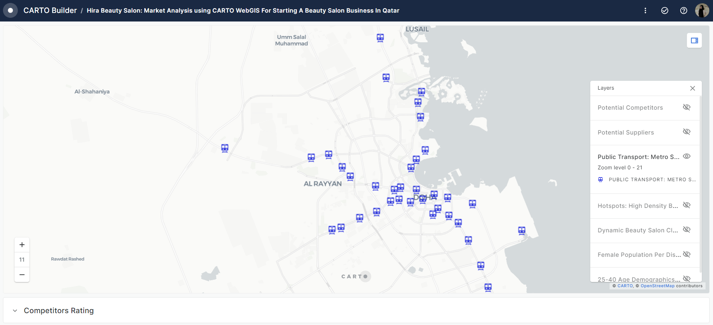
Strategic Location Analysis: Leveraging Metro Stations for Optimal Beauty Salon Placement

Slide 37
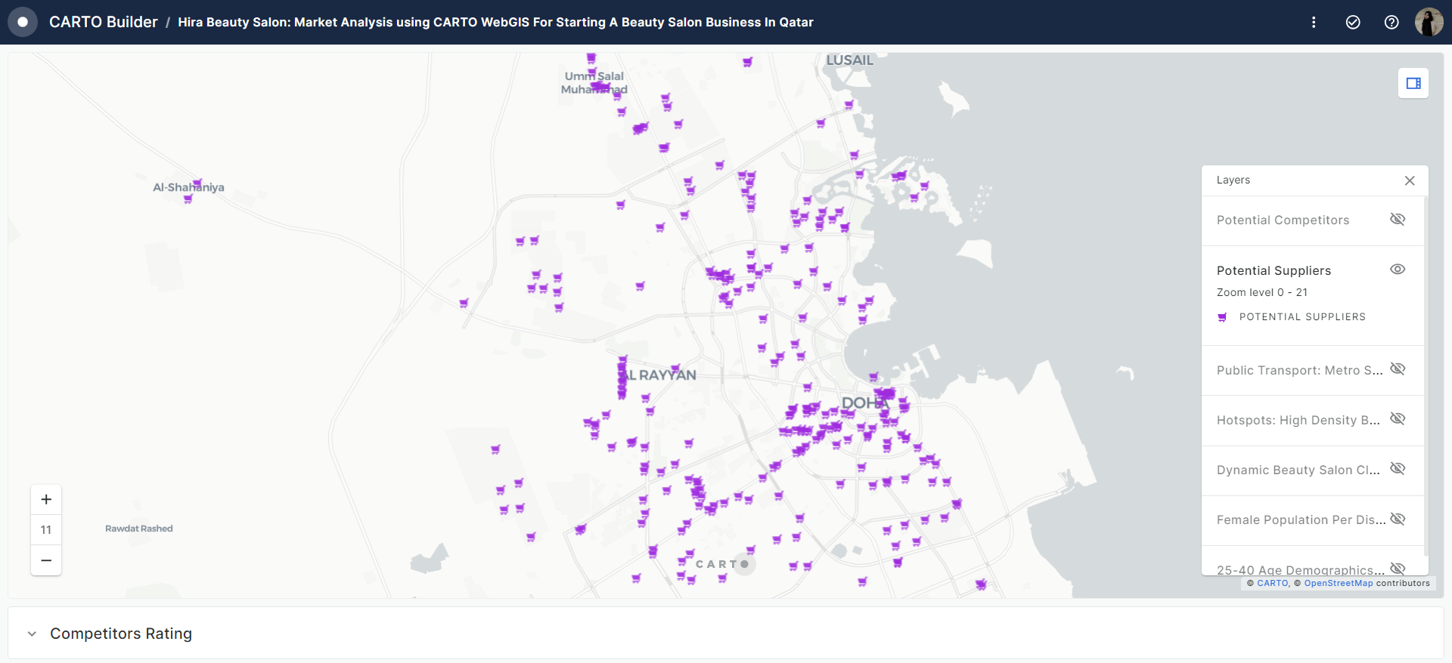
Strategic Location Analysis: Leveraging Suppliers for Optimal Beauty Salon Placement

Slide 38
Evaluating the usability of the 3 webGIS platform interfaces
  Modern, easy to use interface.
  Allows the users to presents the maps in multiple ways: WebApp, Dashboard, Instant App etc.
  Variety of geoprocessing tools to create insightful maps.
  A lot of flexibility with the symbology.
  More control over the design element of the final presentation.
  A very popular platform with active Q/A forum for the users.
  Simple and intuitive interface
  Limited to only webGIS outlook unlike ArcGIS Online.
  Limited Analysis Tools available. Cluster Analysis capability unavailable.
  Limited flexibility with the symbology.
  Comparatively slow processing time.
  Allows the user to add personal logo and banner of the webGIS.
  Simple interface
  Requires training for first time users.
  Limited flexibility with personalizing the webGIS interface for end users.
  A limited number of widgets available with no advanced geoprocessing tools available.
  Table for a layer can be viewed at the user front only if added as a widget unlike ArcGIS online web app where each layer's attribute table can be accessed easily from the layer by default.
  Limited functionality with layer management.
ArcGIS Online
Mango Map
CARTO

Slide 39
Conclusion: Key Takeaways & Step Forward
WebGIS (Web Geographic Information Systems) offers significant value for market analysis by providing a dynamic and interactive platform for spatial data visualization, analysis, and decision-making.
Understanding user requirements is crucial; designing the WebGIS with a user-centric approach ensures that the platform aligns with the needs and expectations of its intended audience.
The success of a WebGIS project depends on the quality of spatial data. Thorough data collection, preparation, and maintenance are crucial for accurate and reliable results.
Only specific capabilities of WebGIS in market analysis are highlighted in this presentation. A lot more insightful analysis can be performed and be presented in unique ways like a dashboard, report etc.
The choice of WebGIS platform significantly influences project outcomes. Each platform has its strengths, so selecting the most suitable one based on project requirements is key.
To conclude, WebGIS enhances market analysis by providing a spatial dimension to data, enabling businesses to make informed decisions, identify opportunities, and gain a competitive edge in dynamic markets⁷.
⁷Mapping services for Location Intelligence and Business Analytics (2023) Utilities One. Available at: https://utilitiesone.com/mapping-services-for-location-intelligence-and-business-analytics (Accessed: 01 December 2023).

